Slide 1
Pinto Variations

Slide 2
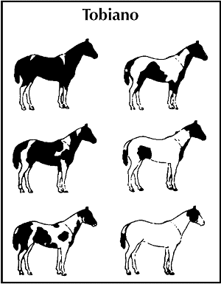
TOBIANO
Patches usually distinct & smooth
Often in oval or circle shapes
Legs are usually white
Head is usually colored
Main & Tail is usually bi-colored
White crosses over back

Slide 3
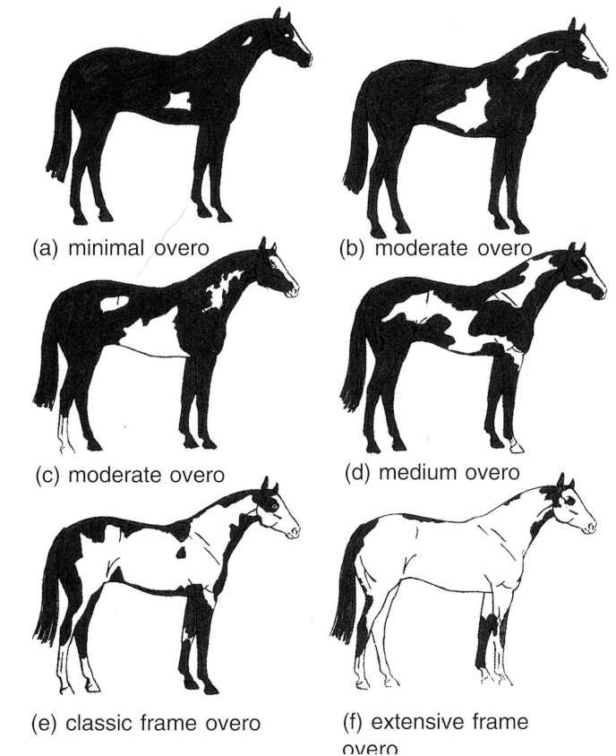
OVERO
White areas are “framed” by color
White does not usually cross over back
Scattered and splashy white
Legs usually solid colored
Tail is usually one color
Large face markings are common

Slide 4
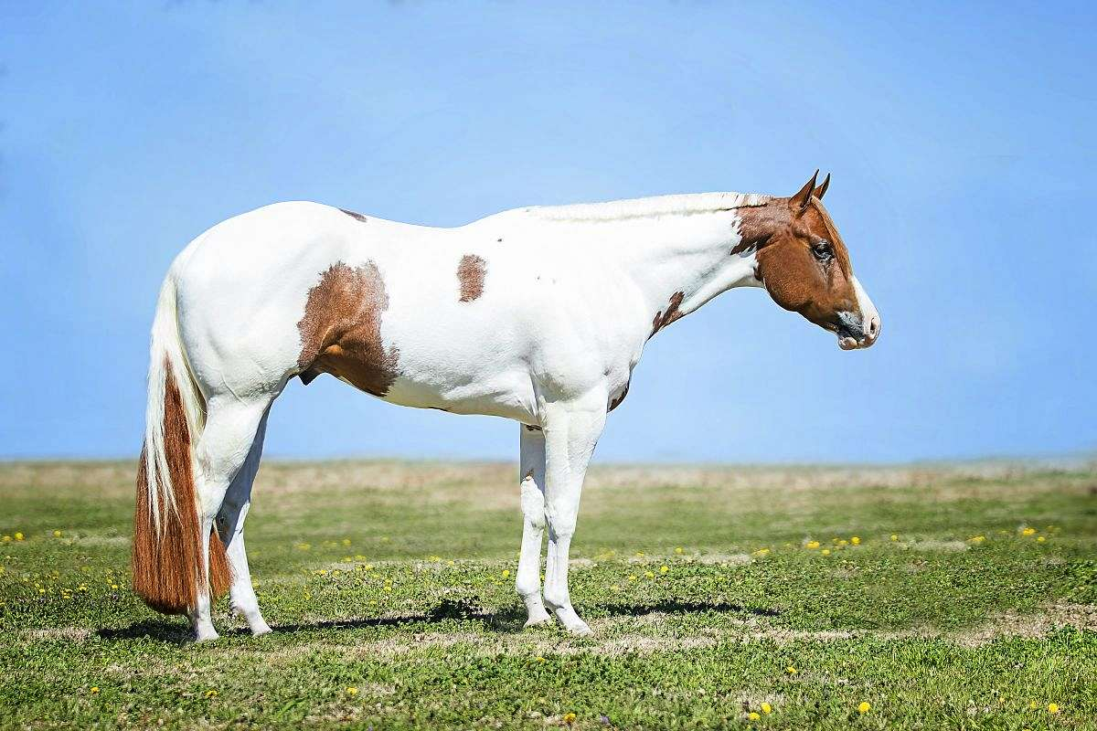
TOVERO
Mix of Overo and Tobiano
Typically has a Medicine Hat marking
Color typically found at ears, corners of mouth, chest, flanks, base of the tail
Common to have one or both eyes blue

Slide 5
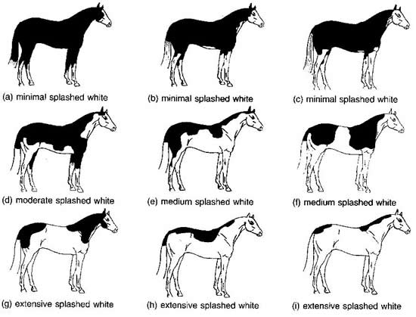
Splashed White
Appears to be dipped in paint
Pattern that limits the white markings to the lower legs and stomach of the horse
All four legs are usually white
Usually have large face markings
Linked to deafness in horses

Slide 6
SABINO
The white usually (but not always) will not cross the back of the horse between its withers and its tail.
Generally, at least one and often all four legs are white.
Generally, the white is irregular, and is rather scattered or splashy.
Tail is usually one colour but not always.

